Slide 1
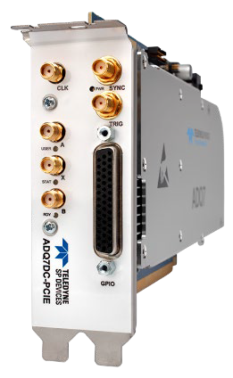

FWPD Webinar
Intelligent Pulse Detection
Byron Gao
APAC(China) Application Engineer

Slide 2
Agenda
Intelligent pulse detection
  Pulse Detection Solution & Supported Products
  Pulse Detection Application Examples
  FWPD Pulse Detection Feature Overview
    Digital Baseline Stabilization (DBS)
    Detection Window
    Coincidence
    Intelligent Pulse Detection
    Hysteresis
    Real-time or Custom Pulse Analysis
    Data collection and Data Multiplexer
    Timestamp
    Latency Control

Slide 3
Pulse Detection Solution
High performance digitizers ADQ7 and ADQ14
  Standard FW FWDAQ included
Pulse Detection FW FWPD for ADQ7 and ADQ14
  FW FWPD is an add on option
Pulse Characterization GUI application
Example application code in C and Python
FWPD User’s Guides for ADQ7 and ADQ14
Pulse Detection application note

Slide 4
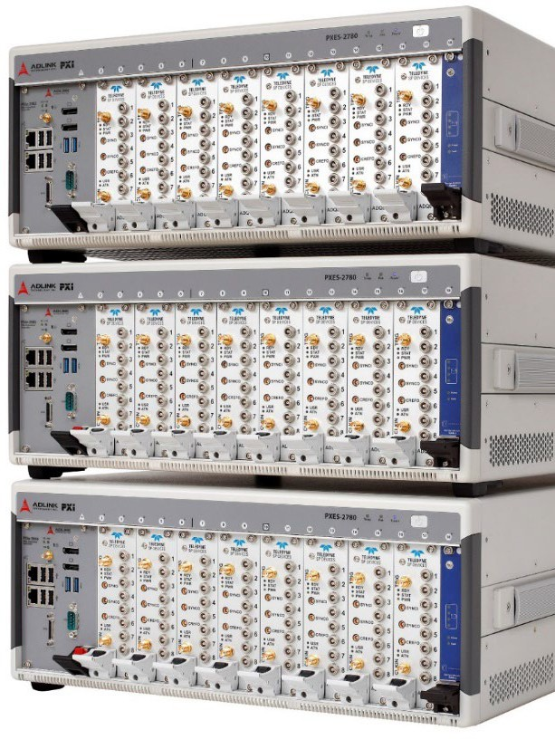
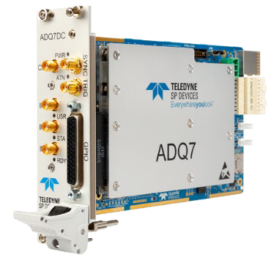
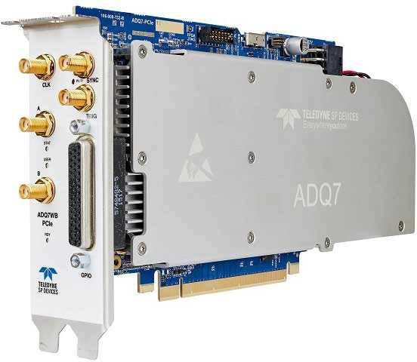
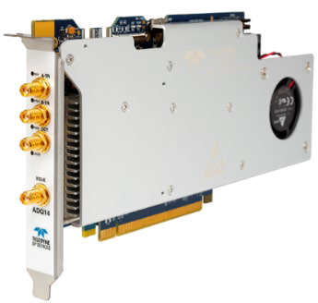
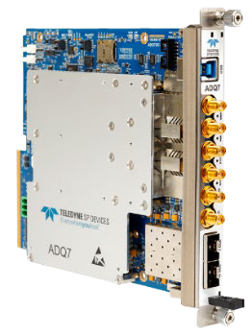
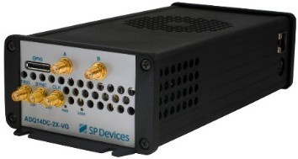
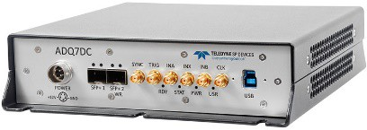
FWPD – On ADQ7 and ADQ14
Flexible choice of product and form factor
PXIe
PCIe
SSPCIe
USB3.0
10GbE
MTCA.4

Slide 5
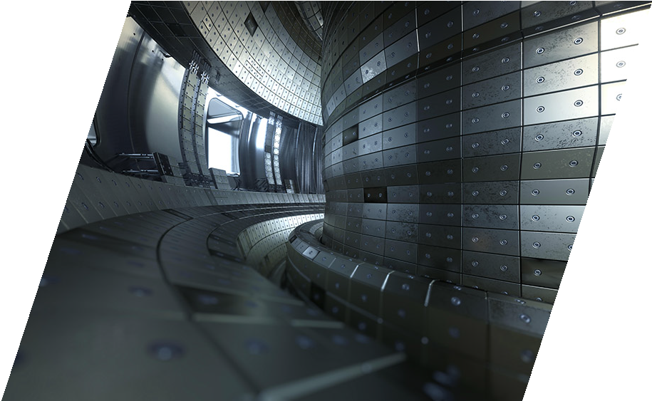
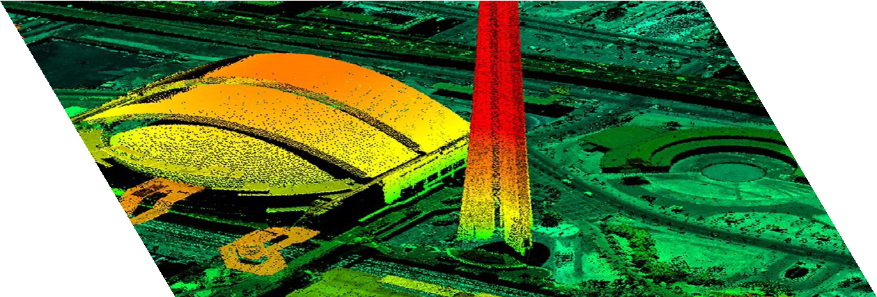
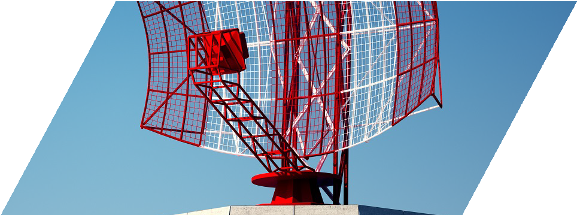
Pulse Detection Application Examples
Big Physics
Time-of-flight
Scientific instruments
LIDAR
RADAR
Neutron time-of-flight

Slide 6

Pulse Detection Overview
Create a stable and smooth baseline
DBS
Ignore pulses outside the detection window
Detection window
Channel trigger is conditioned by activity on other channels
Coincidence
Dynamic recording, dynamic level trigger, and zero suppression
Pulse detection
Real-time analysis in the FPGA
Pulse analysis
Flexible detection and presentation of metadata
Data collection
Ensures a constant minimum data rate from the digitizer
Timestamp for real-time timing
Latency control Timestamp

Slide 7

Digital Baseline Stabilization (DBS)
DBS
DBS tracks slow and periodic baseline variations originating from:
Detection window
Temperature variations
Component aging
Pattern noise from ADC due to interleaving
Coincidence
Pulse detection
DBS helps avoid false readings and/or performance degradation:
Pulse analysis
Missed pulses
Erroneous detection of false pulses
Incorrect analysis of pulse characteristics
Data collection
Latency control Timestamp

Slide 8
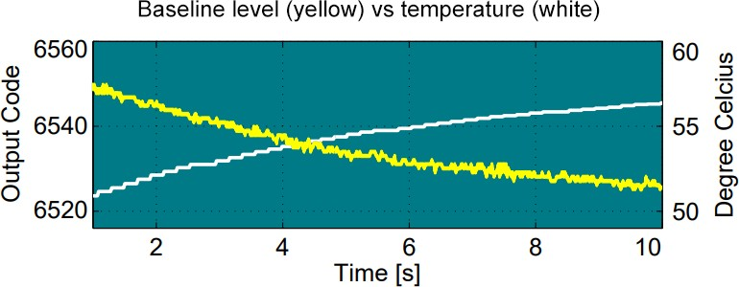
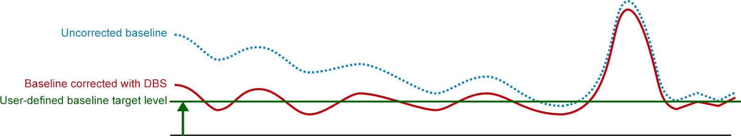
Digital Baseline Stabilization with DBS
DBS
Baseline variation over time
Detection window
Coincidence
Pulse detection
Pulse analysis
Data collection
Latency control Timestamp

Slide 9

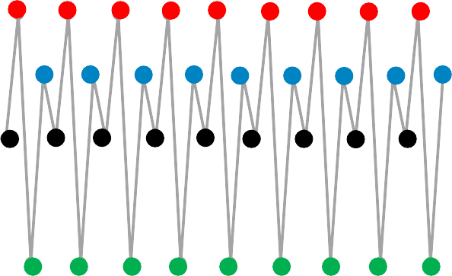
Pattern Noise Reduction with DBS
Multiple interleaved ADC cores with different offset
Results in a periodic zig-zag pattern in the output:
DBS
Detection window
3,5
3
2,5
2
1,5
1
0,5
0
-0,5
-1
-1,5
Coincidence
0 10 | 20 | 30 | 40
ADC
Pulse detection
ADC
ADC
Pulse analysis
ADC
Data collection
Interleaved digital output
Latency control Timestamp

Slide 10
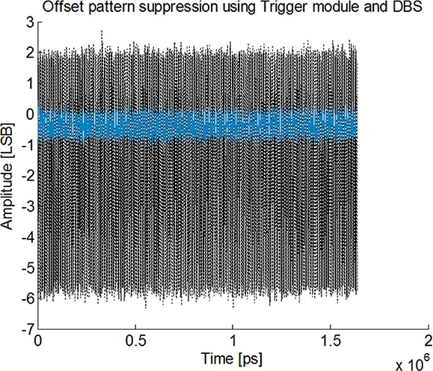
Pattern Noise Reduction with DBS, continued
DBS
Significant pattern noise suppression with DBS
Detection window
Coincidence
Pattern noise with DBS
Pulse detection
Pattern noise without DBS
Pulse analysis
Data collection
Latency control Timestamp

Slide 11
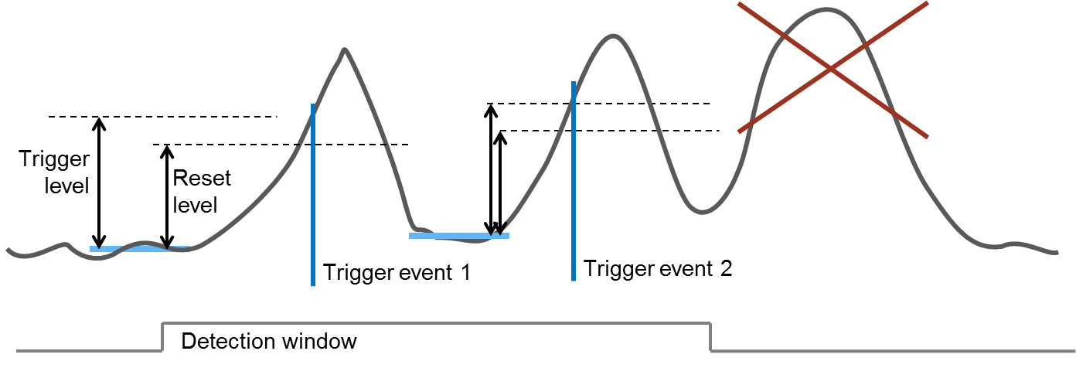
Detection Window
DBS
Events outside the detection window ignored
Detection window
Coincidence
Pulse detection
Pulse analysis
Data collection
Latency control Timestamp

Slide 12
Example of use - Detection Window
Use window to synchronize to a shot of particles
Select reasonable flight-time only
Discriminate outliers
Target
Source
Detector

Slide 13
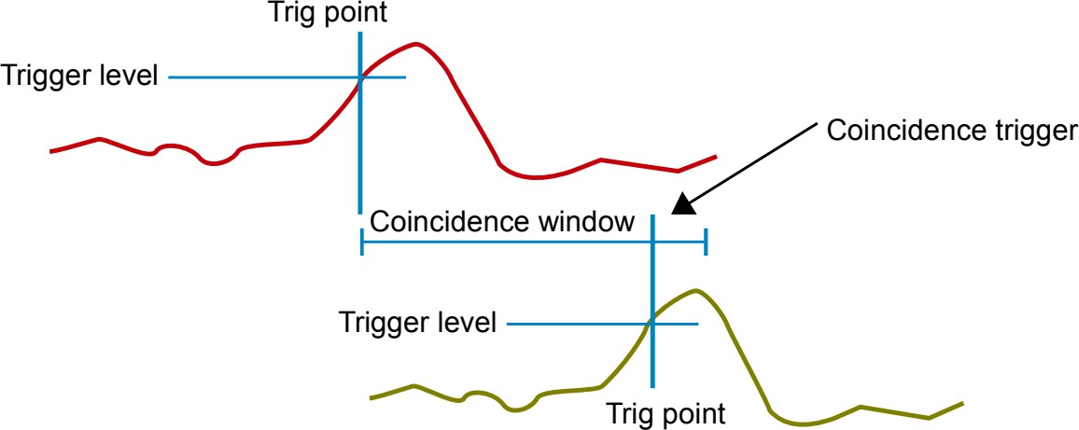
Coincidence
DBS
Coincidence used for channel-dependent triggering
Detection window
Coincidence
Pulse detection
Pulse analysis
Data collection
Trigger event on green channel only if it occurs within a configurable timeslot (the coincidence window) after the red channel is triggered.
Latency control Timestamp

Slide 14
Example of use - Coincidence
Study flight time of particles
Multiple sets of detectors
Particles/pulses only stored if hitting multiple detectors within a certain time frame
Other pulses are discarded to reduce data to be transferred/stored
Timestamp is used to determine flight time between detectors

Slide 15
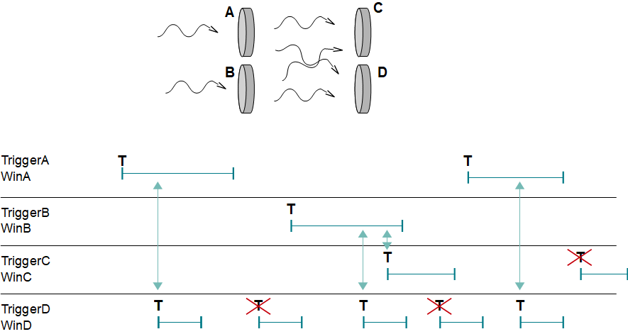
Example of use - Coincidence, continued
Time-of-flight example

Slide 16
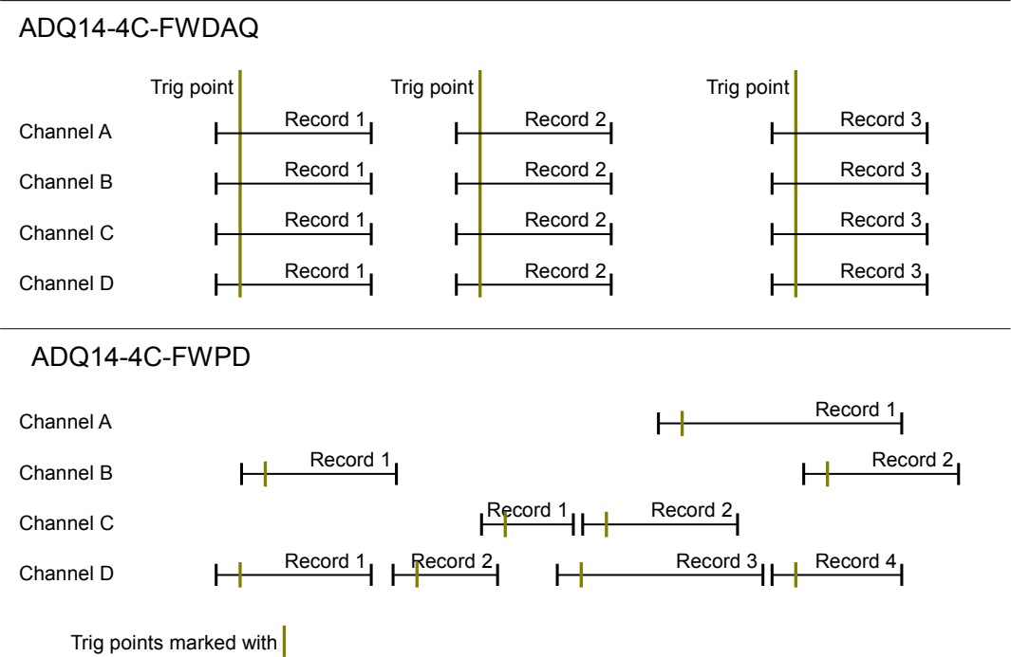
Intelligent Pulse Detection vs Standard Data Acquisition
Individual channel and dynamic data-driven record length
  Fixed vs variable record lengths
Fixed record length
DBS
Detection window
Coincidence
Pulse detection
Pulse analysis
Variable record length
Data collection
Latency control Timestamp

Slide 17
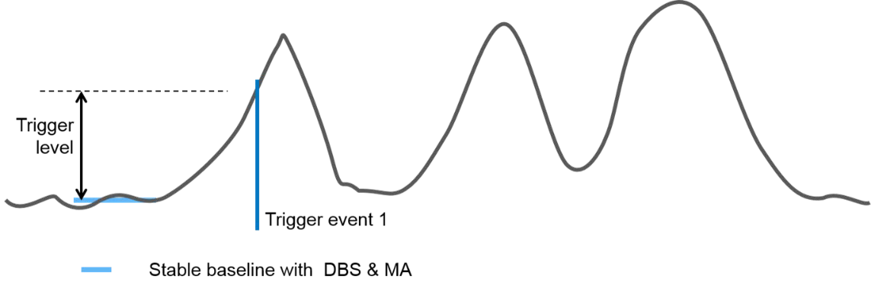
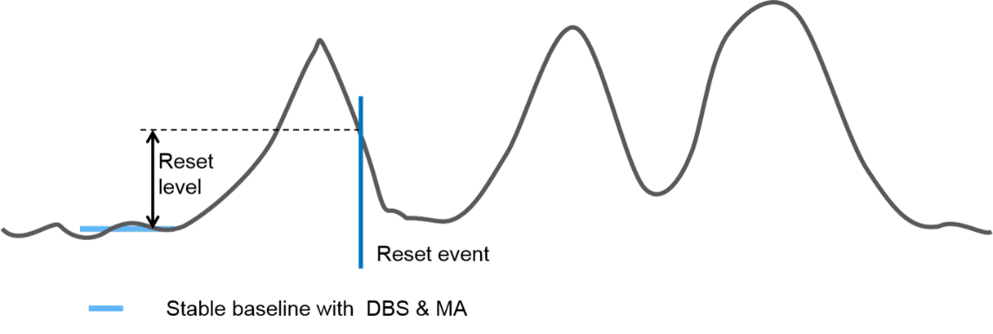
Intelligent Pulse Detection
Trigger and reset levels relative to stable baseline
  Determines beginning and end of pulse data record
DBS
Detection window
The pulse start is determined by the trigger level.
Coincidence
Pulse detection
Pulse analysis
The pulse end is determined by the reset level.
Data collection
Latency control Timestamp

Slide 18

Example of use – Dynamic Data-Driven Record Length
Any radiation source has a random generation of particles
Optimize recording/transfer to only include meaningful data
Example application - Thomson scattering in fusion reactors

Slide 19
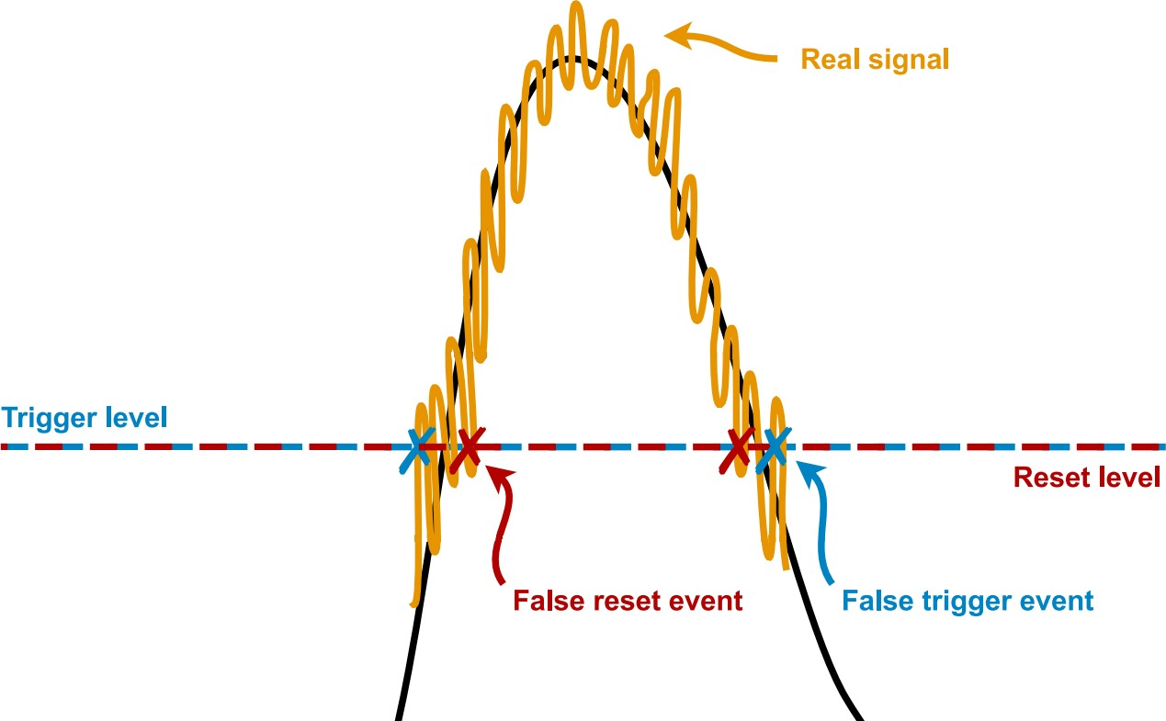
Valid Trigger/Reset Points
DBS
Signal may contain noise that results in false trigger/reset
Detection window
Coincidence
Pulse detection
Pulse analysis
Data collection
Latency control Timestamp
Safety mechanism required that prevents false events

Slide 20
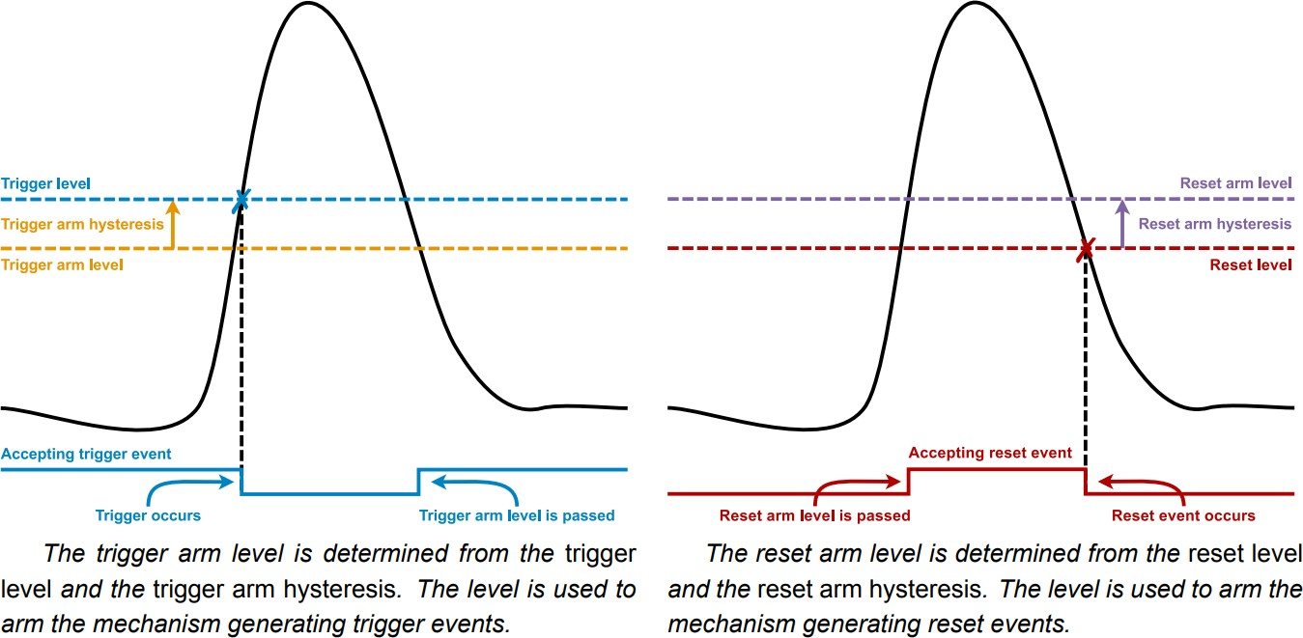
Trigger/Reset Arm Hysteresis
DBS
Help with trade-off between accepting false events and missing out on real pulses
Detection window
Coincidence
Pulse detection
Pulse analysis
Data collection
Latency control Timestamp

Slide 21
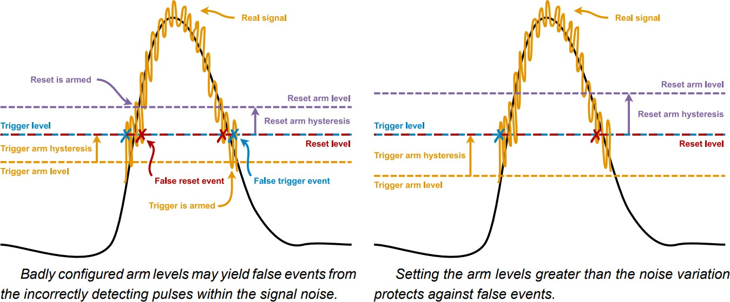
Trigger/Reset Arm Hysteresis, cont’d
DBS
Help with trade-off between accepting false events and missing out on real pulses
Detection window
Coincidence
Pulse detection
Pulse analysis
Data collection
Latency control Timestamp

Slide 22
Intelligent Pulse Detection – Edges
DBS
Mechanism to enable study of pulse edges
Detection window
Trigger level
LEW
Coincidence
TEW
Reset level
Pulse detection
Pulse analysis
Region of interest
Data collection
Leading Edge Window (LEW) before trigger point Trailing Edge Window (TEW) after reset point
Latency control Timestamp

Slide 23
Examples of use – LEW/TEW
Pulse length vary on a radiation decay
If pulses (particles) pile up the length of the pulse vary
Optimal transmission of data

Slide 24
Real-time Pulse Analysis
Built-in real-time pulse analysis
  Peak value, time over threshold (width), peak timestamp
DBS
Detection window
Coincidence
Peak
Pulse detection
LEW
TEW
Width
Pulse analysis
Data collection
Time of peak
Latency control Timestamp

Slide 25
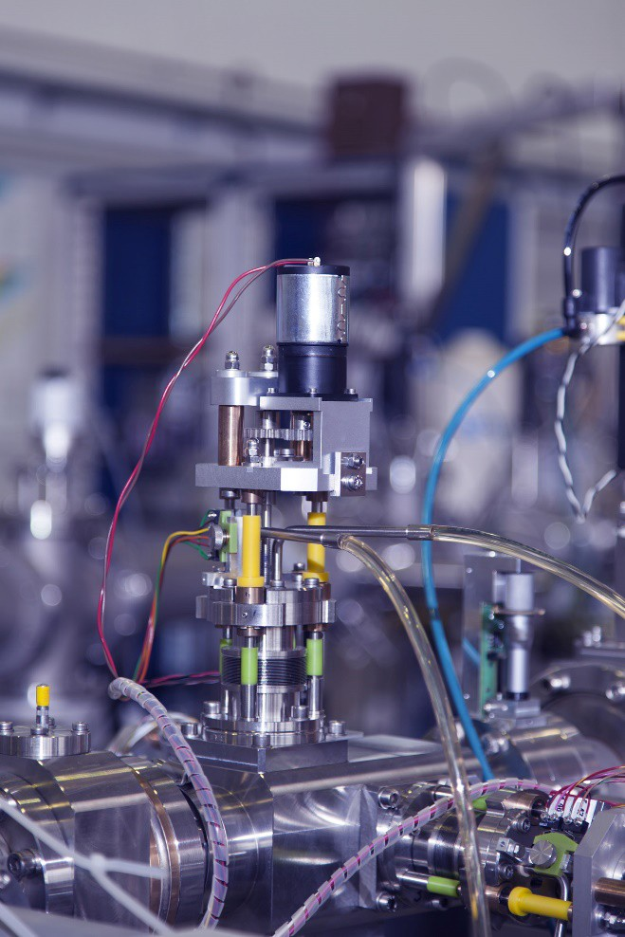
Examples of use – Pulse Analysis
Peak detection in time-of-flight mass spectrometry (TOFMS)
Area is energy

Slide 26


Custom Pulse Analysis
Open FPGA enables custom real-time pulse analysis
  Examples – area, power, custom peak definition, Gaussian curve fit, spline interpolation, qualify/disqualify pulse, etc.
DBS
Detection window
Coincidence
Pulse detection
LEW
TEW
Pulse analysis
Data collection
Latency control Timestamp
Available via firmware development kit or design service

Slide 27


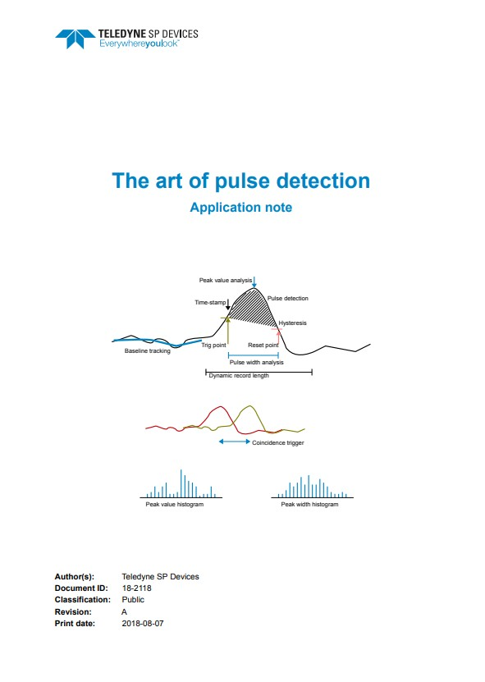
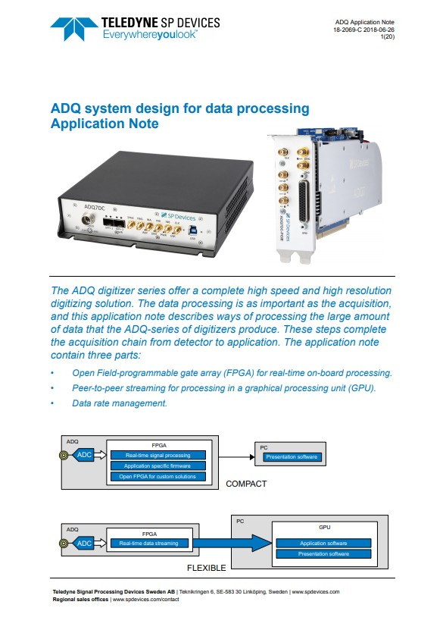
Examples of end use – Custom Pulse Analysis
Custom processing in real-time optimized for any application
See application notes for examples and further information

Slide 28
Data Collection
DBS
Five data collection modes for different purposes:
Overview summary
Detection window
Mode | Trigger Types | Detection Window | Data Type | Data Padding | _{N}th Record
0 | All | No | Raw | No | No
1 | Level | Yes | Meta | Yes | No
2 | All | No | Raw | No | Yes
3 | Level | Yes | Raw | Yes | No
4 | Level | No | Raw | Yes | No
Coincidence
Pulse detection
Pulse analysis
Data collection
Latency control Timestamp

Slide 29
Data Collection
DBS
Five data collection modes for different purposes:
0. Default. Most features turned off.
Detection window
Fixed length raw data records with any trigger source
Variable length raw data records with level trigger
Coincidence
1. Pulse metadata within detection window is collected.
Packets of metadata are structured into records
Same as Mode 0, but only every N^{th} record is collected.
Similar to Mode 1, but with raw data instead of metadata.
  Variable length records of raw pulse data
Same as Mode 3, but without detection window.
Pulse detection
Pulse analysis
Data collection
Latency control Timestamp

Slide 30
Data Collection, cont’d
DBS
Collected data is stored into records
Both data and header records created
Timestamp included in header
Records are transferred to host
Detection window
Coincidence
Some modes can be combined
Multiplexer with meta & raw data channels
For example mode 1 & 3
Pulse detection
Pulse analysis
Data collection
Latency control Timestamp

Slide 31


Intelligent Data Collection with Data Multiplexer
DBS
MUX
3
1
FPGA
A
AFE
ADC
Record frame
Raw data A
PC
Detection window
Pulse detection
Use cases:
Coincidence
Standard pulse char.
Pulse detection
Custom pulse char.
Normal operation
3
1
Raw data A Pulse char. A
Custom pulse char.
Pulse analysis
Standard pulse char.
Data collection
Pulse detection
Pulse characteristics A
Latency control Timestamp
B
AFE
ADC
Record frame

Slide 32
Examples of use – Data Multiplexer
This is typically used during application development
Compare raw data with analyzed for development/debugging

Slide 33

Intelligent Data Collection with Data Multiplexer
DBS
MUX
3
3
FPGA
A
AFE
ADC
Record frame
Raw data A
PC
Detection window
Pulse detection
Use cases:
Coincidence
Standard pulse char.
Pulse detection
Custom pulse char.
Normal operation
3
3
Raw data A Raw data B
Custom pulse char.
Pulse analysis
Standard pulse char.
Data collection
Pulse detection
Raw data B
Latency control Timestamp
B
AFE
ADC
Record frame

Slide 34
Intelligent Data Collection with Data Multiplexer
DBS
MUX
1
1
FPGA
A
AFE
ADC
Record frame
Pulse characteristics A
PC
Detection window
Pulse detection
Use cases:
Coincidence
Standard pulse char.
Pulse detection
Custom pulse char.
Normal operation
1
1
Pulse char. A Pulse char. B
Custom pulse char.
Pulse analysis
Standard pulse char.
Data collection
Pulse detection
Pulse characteristics B
Latency control Timestamp
B
AFE
ADC
Record frame

Slide 35








Data Collection - Mode 3 and 4 (raw data)
Record
DBS
Header
Data
Detection window
Coincidence
LEW
TEW
LEW
TEW
Pulse detection
Pulse analysis
Discarded
Pulse #1 Pulse #2
Discarded
Discarded
Data collection
Raw data of pulses 1 and 2 are collected in two separate records. All other data is discarded to optimize the amount of data processed and transferred to the PC.
Latency control Timestamp

Slide 36

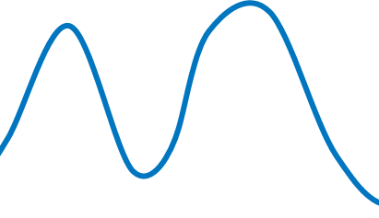

Data Collection - Mode 3 and 4 with LEW/TEW Overlap
DBS
If LEW and TEW overlap, the record is extended to contain both pulses in the same record
Detection window
Trigger 1
Trigger 2
Coincidence
Pulse detection
LEW
LEW
LEW
TEW
TEW
TEW
Pulse analysis
Data collection
Record #1
Record #2
Latency control Timestamp

Slide 37



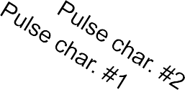

Data Collection - Mode 1 (metadata)
DBS
Pulse characteristics are stored in metadata packets
Header Pulse #1 Pulse #2 #3 #n
Detection window
Peak 16b
Width 16b
Time of peak 32b
Peak 16b
Width 16b
Time of peak 32b
Time-stamp 64b
Coincidence
Header Pulse #1 Pulse #2
#3 #n
Pulse detection
Cust. value1 x bits
Cust. value2 y bits
…
Cust. value1 x bits
Cust. value2 y bits
…
Time-stamp 64b
Pulse analysis
Metadata record
Header
…
Data collection
Latency control Timestamp

Slide 38
Timestamp
DBS
Peak timestamp definition dependent on Detection Window
Peak
Detection window
Trigger
Coincidence
Pulse detection
Header timestamp if no detection window
Peak timestamp if no detection window
Pulse analysis
Header timestamp if detection window
Peak timestamp if detection window
Data collection
Detection window
Latency control Timestamp

Slide 39








Timestamp – Header without Detection Window
DBS
Detection window
LEW
TEW
LEW
TEW
Coincidence
Pulse #1
Pulse #2
Pulse detection
Timestamp in header
Timestamp in header
Pulse analysis
Raw data channel
Pulse char. channel
Header
Raw data #1
Header
Raw data #2
Data collection
Header
Pulse char. #1
Header
Pulse char. #2
Latency control Timestamp

Slide 40


Timestamp – Header with Detection Window
DBS
External trigger
Detection window
Timestamp reset
Timestamp
Coincidence
Pulse detection
LEW
TEW
LEW
TEW
Pulse analysis
Pulse #1
Pulse #2
Data collection
Timestamp in header
Timestamp in header
Latency control Timestamp

Slide 41
Controlling Pulse Data Latency
In data-driven acquisition the latency is high if pulses are sparse
This is sometimes not acceptable
One example is updating plots/diagrams in a graphical user interface
A time-out mechanism required to force data transfer if time between consecutive pulses is too long
Padding helps fill the data pipeline/FIFO with dummy data (zeros)
Padding is recognized as dummy data by the application software and discarded

Slide 42
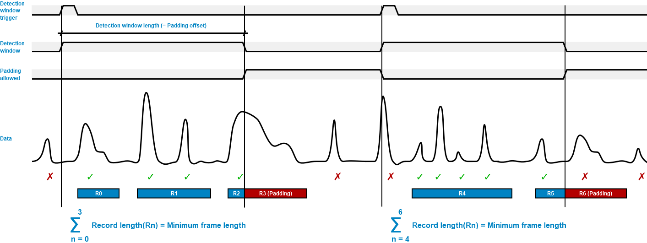
Latency Control - Padding with Detection Window
DBS
Padding helps ensure constant data rate
Detection window
Coincidence
Pulse detection
Pulse analysis
Data collection
Latency control Timestamp

Slide 43

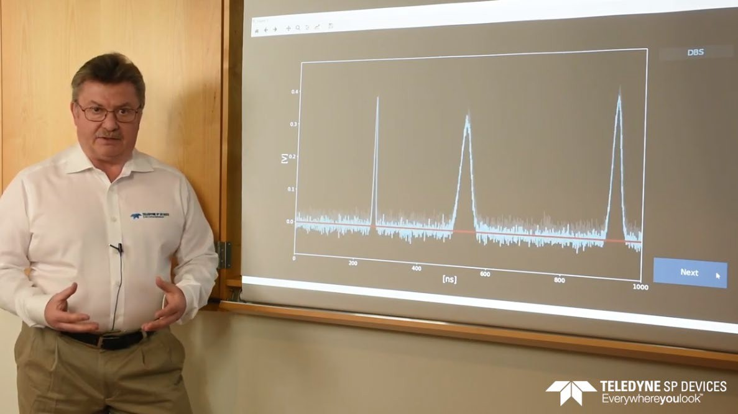
Intelligent Pulse Detection Demo
Demo video to review some FWPD features discussed
FWPD feature overview video also available here

Slide 44
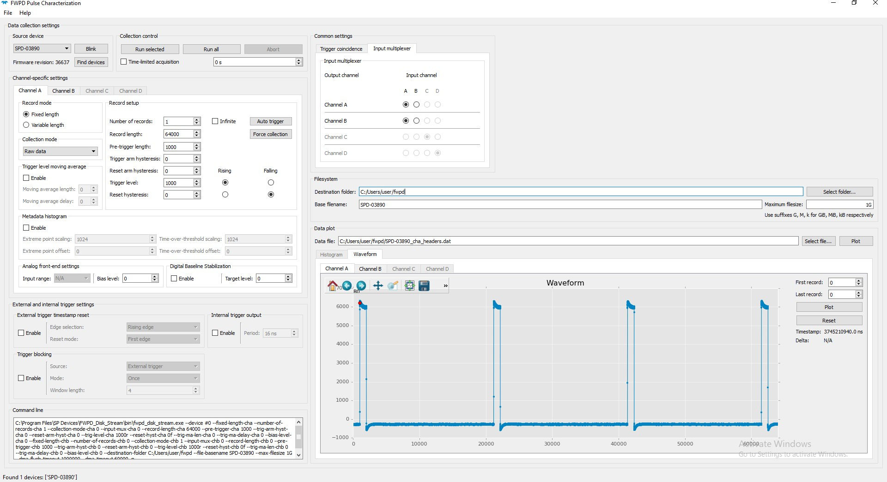
Application example: Pulse Characterization GUI

Slide 45




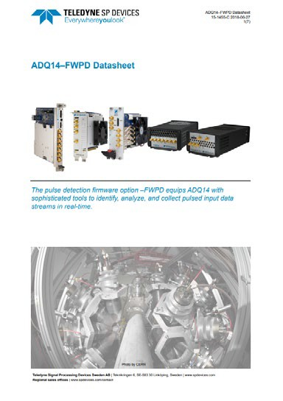
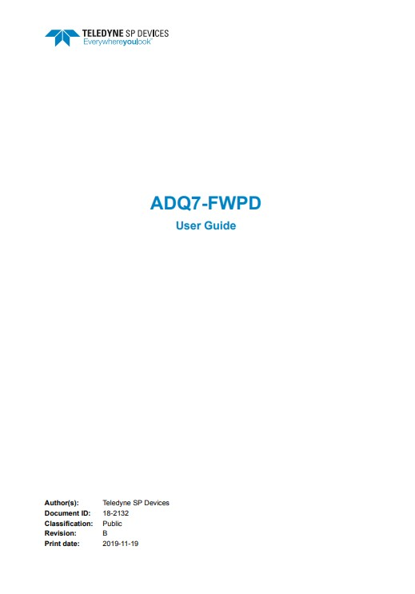
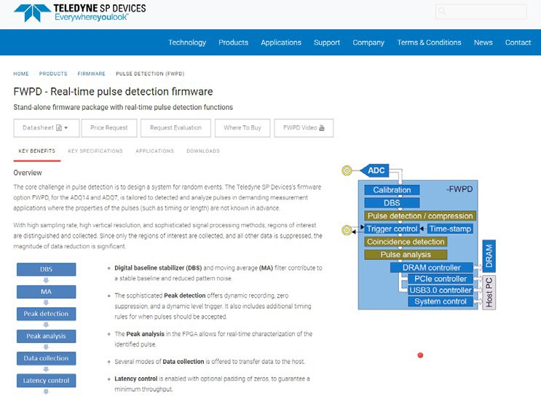
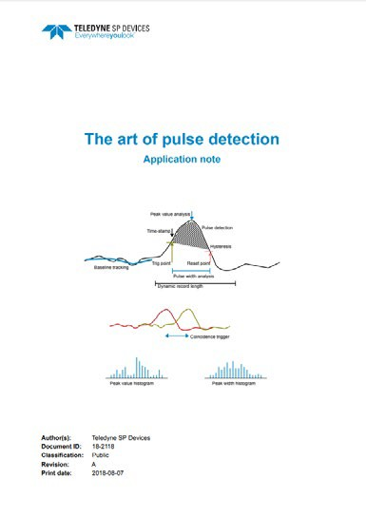
Further Documentation Information
FWPD datasheet for ADQ7 here and ADQ14 here
FWPD user guide for ADQ7 here and ADQ14 here
FWPD website here
“The art of pulse detection” application note, here

Slide 46




Contacts
Byron Gao
APAC(China) Application Engineer
Peng.Gao@Teledyne.com

